Slide 1
Azure

Slide 2
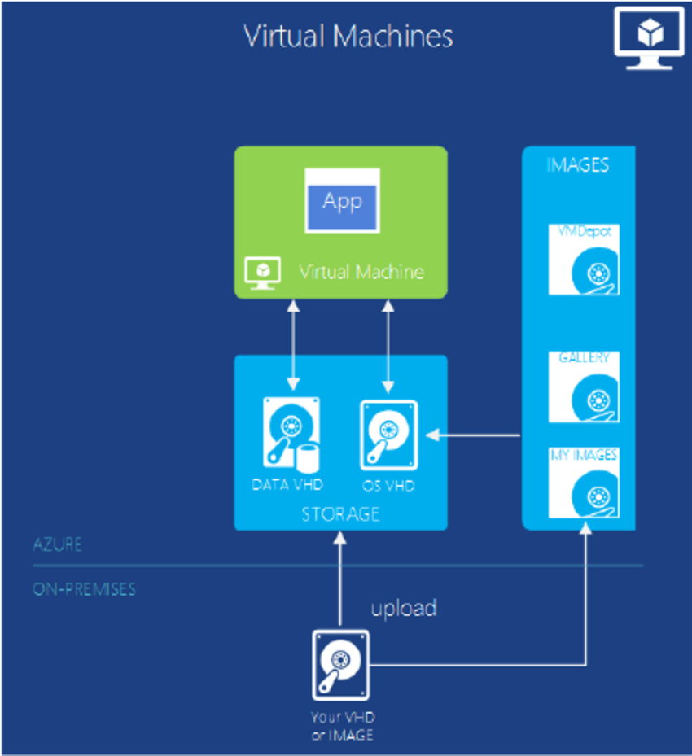
Azure VM

Slide 3
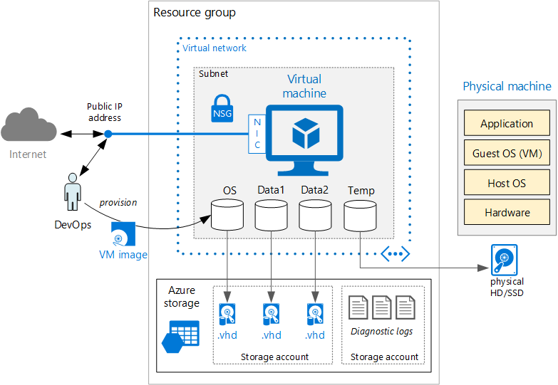
Azure VM, Subnet, VNet, Resource Group

Slide 4
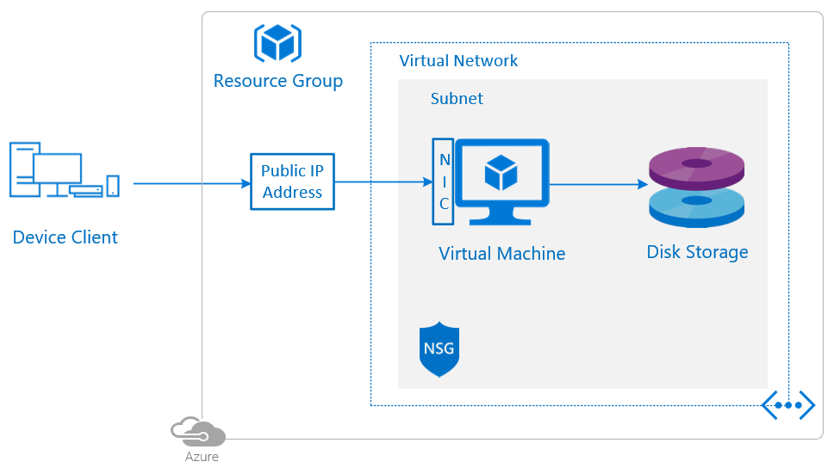
Azure VM, Subnet, VNet, NSG, Public IP, Disk

Slide 5

Azure VM, Subnet, VNet, NSG, Public IP, Disk

Slide 6
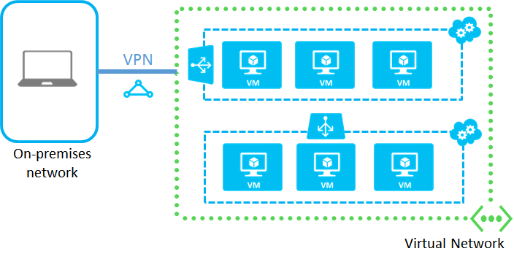
Azure VPN

Slide 7
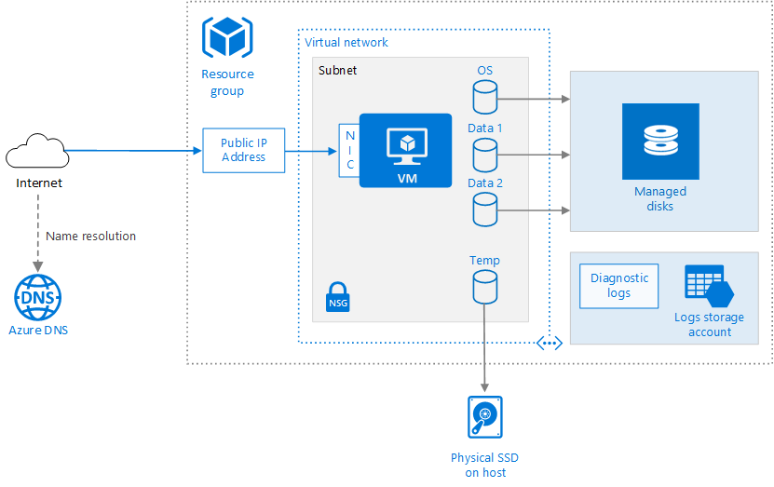
Azure VM, Subnet, VNet, NSG, Public IP, Disk

Slide 8
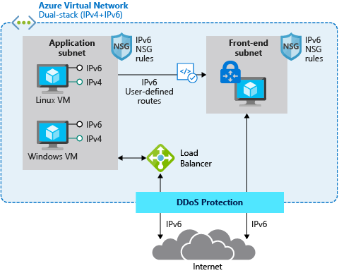
DDos Protection, Load Balancer

Slide 9
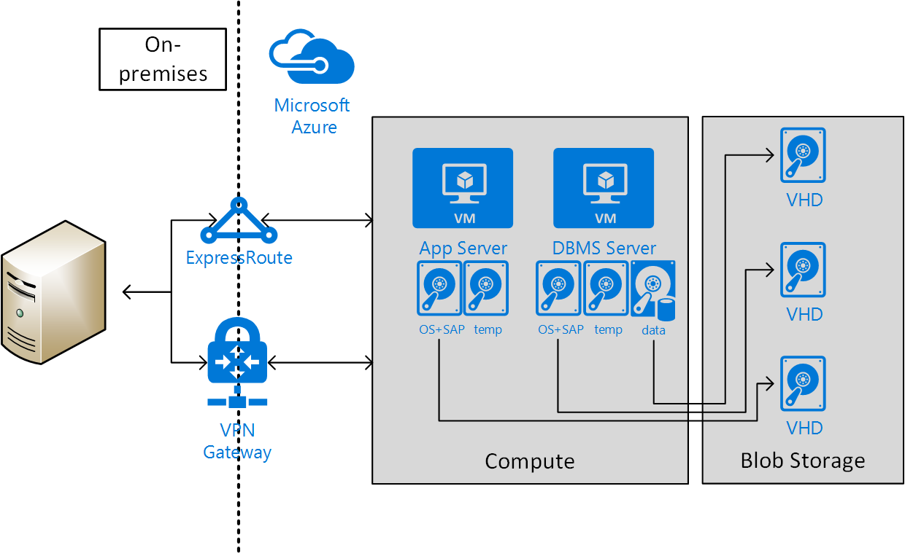
VPN Gateway, Express Route

Slide 10
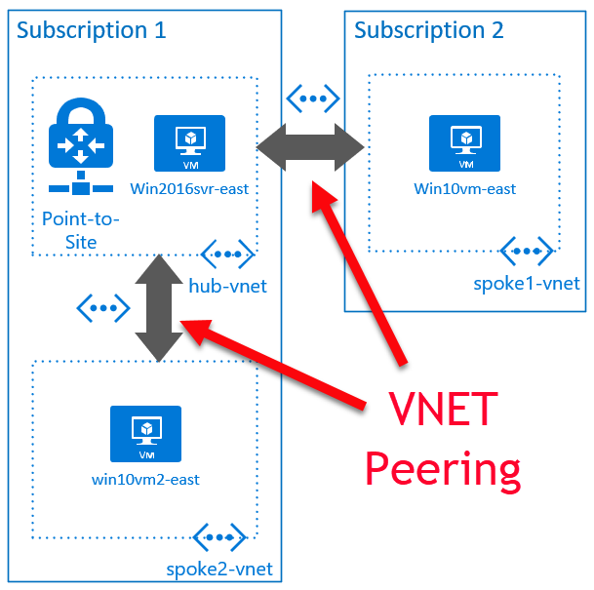
VNet Peering

Slide 11
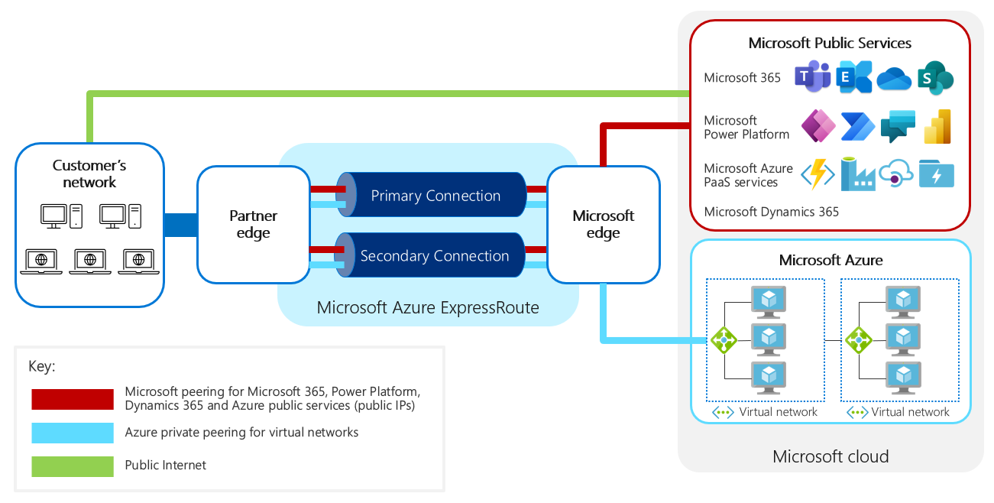
Express Route

Slide 12
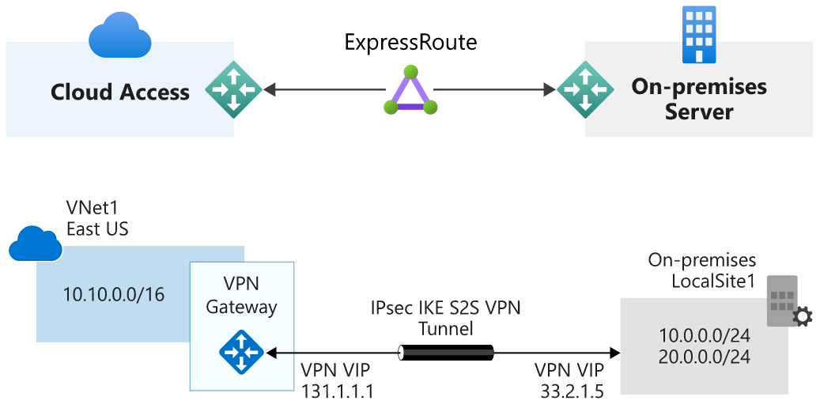
Express Route vs VPN Gateway

Slide 13
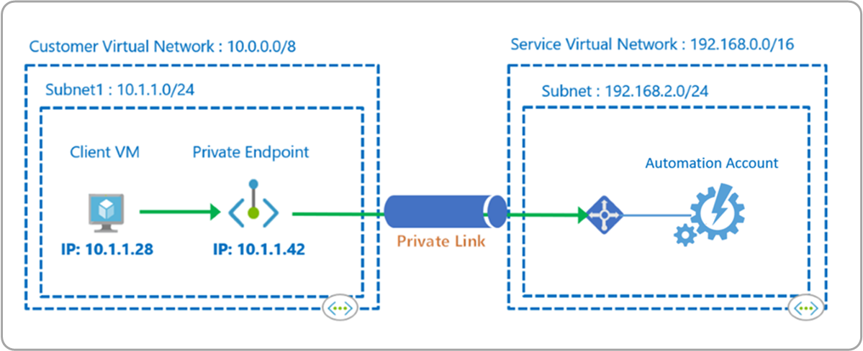
Private Endpoint

Slide 14
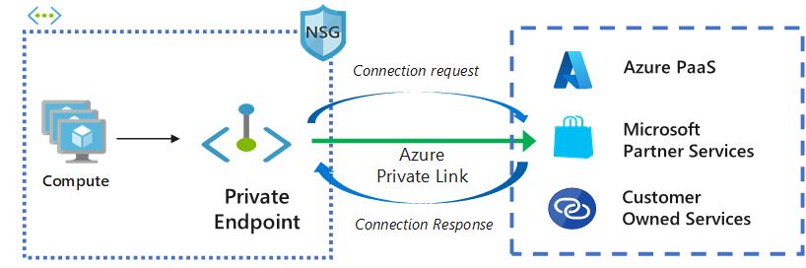
Private Endpoint

Slide 15
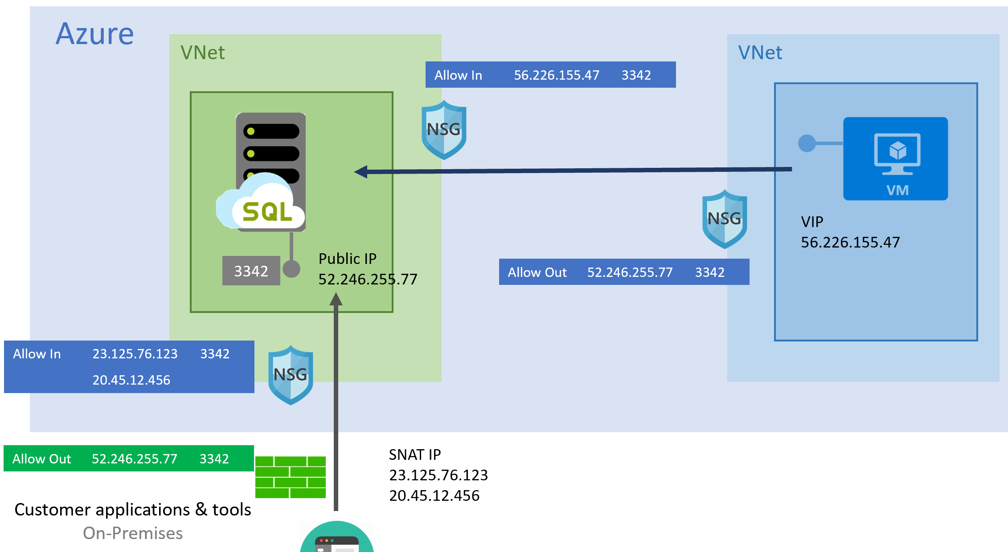
Public Endpoint

Slide 16
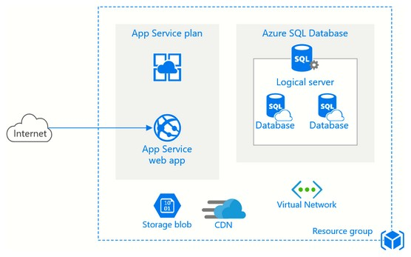
Azure App Service

Slide 17
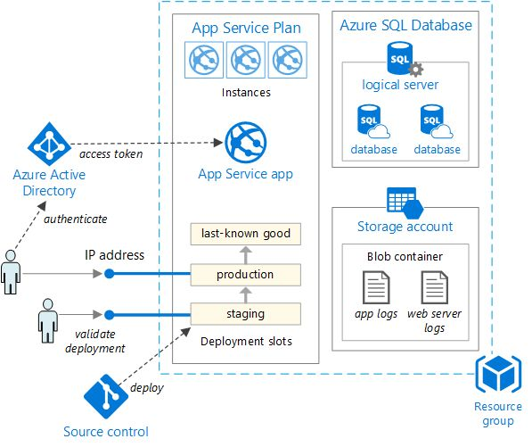
Azure App Service

Slide 18
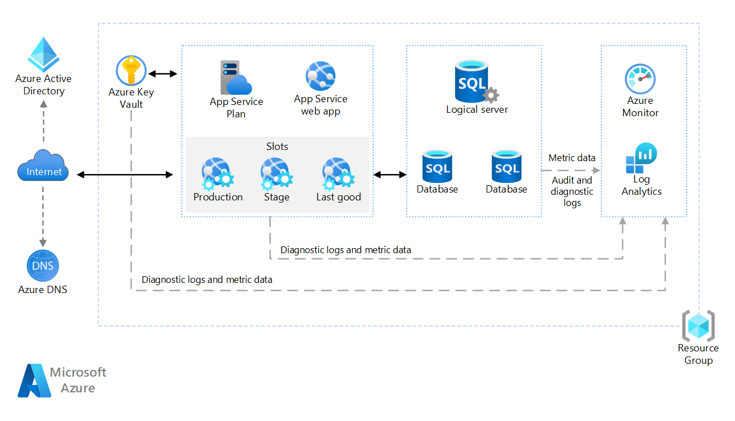
Azure App Service, Key Vault, Monitor, DNS

Slide 19
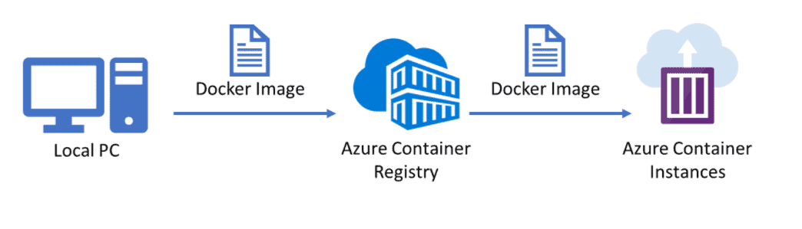
Azure Container Instances

Slide 20
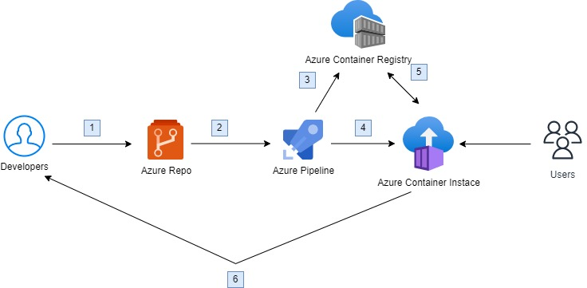
Azure Container Instances

Slide 21
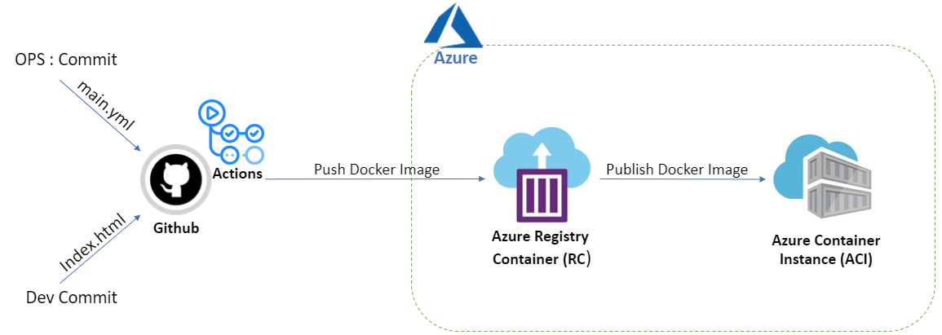
Azure Container Instances

Slide 22
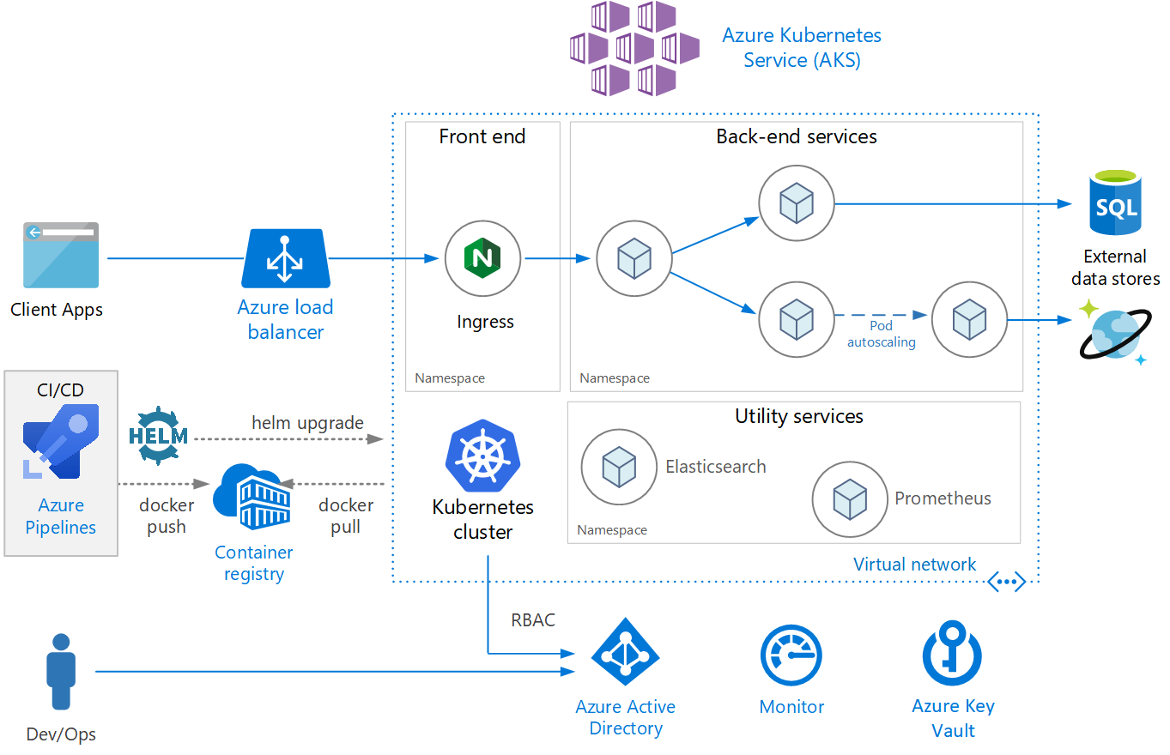
AKS

Slide 23
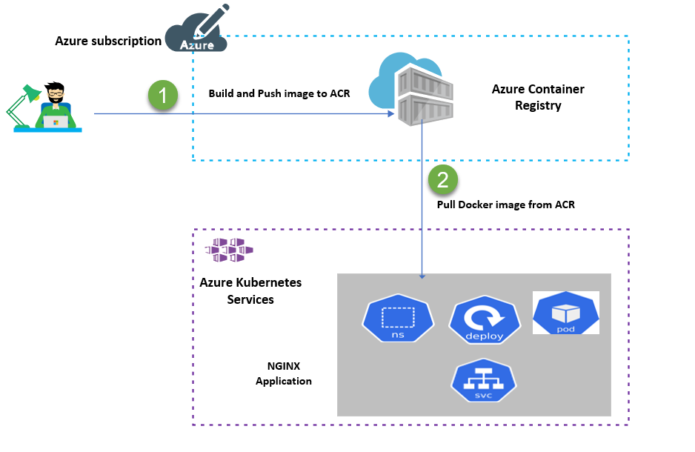
AKS and ACR

Slide 24
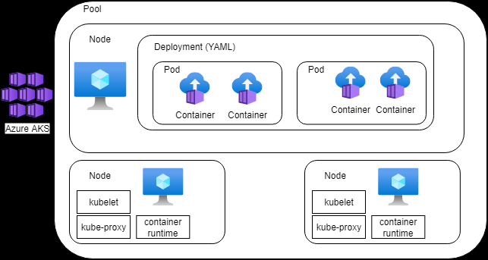
AKS Nodes and Pods

Slide 25
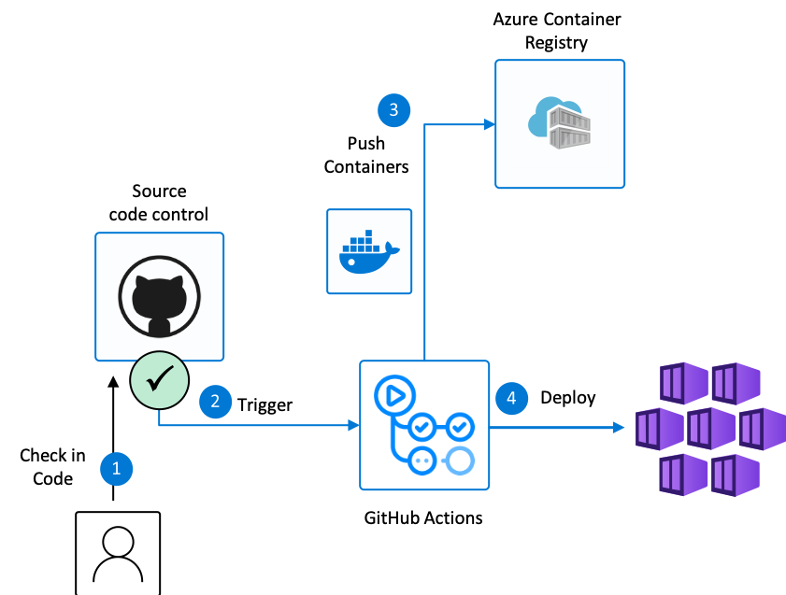
DevOps flow to deploy to AKS

Slide 26
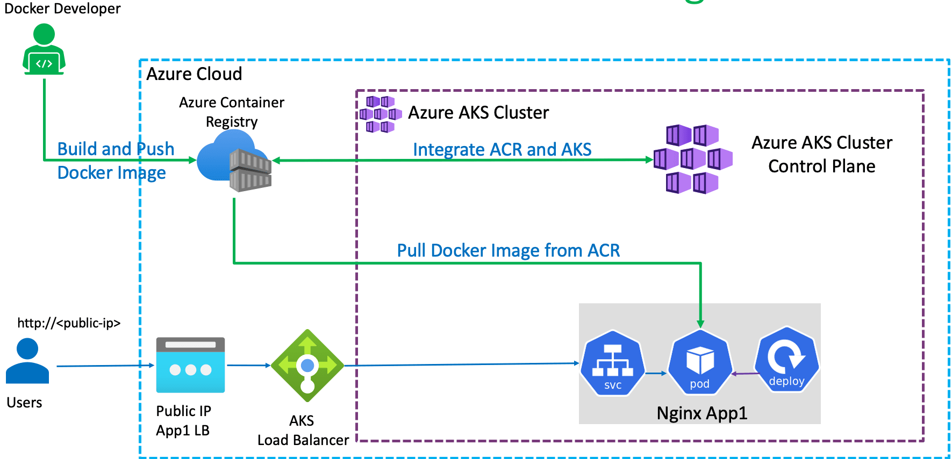
Azure ACR and AKS Integration

Slide 27
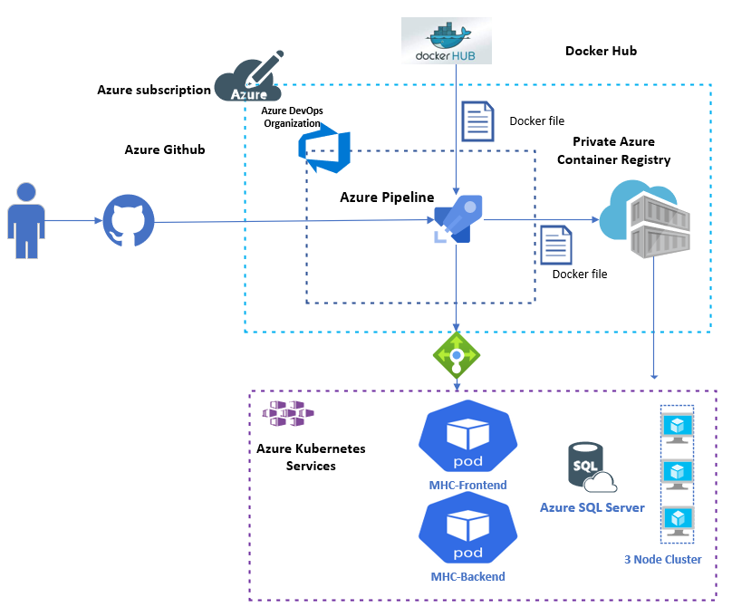
Azure DevOps and AKS

Slide 28
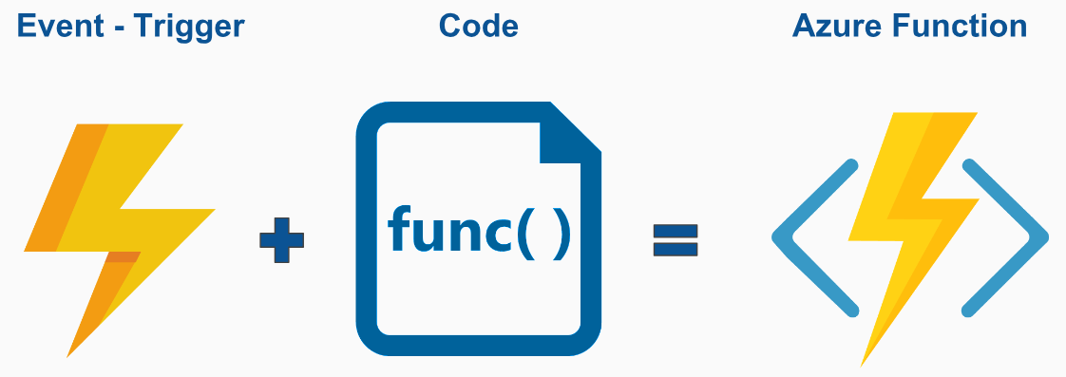
Azure Function

Slide 29
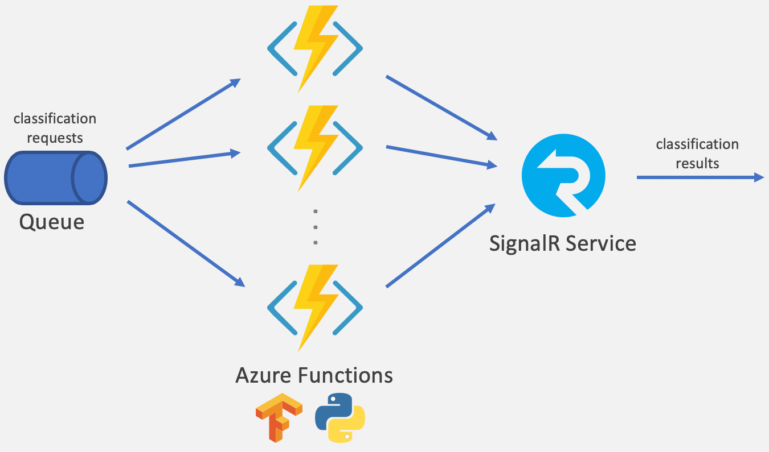
Azure Function

Slide 30
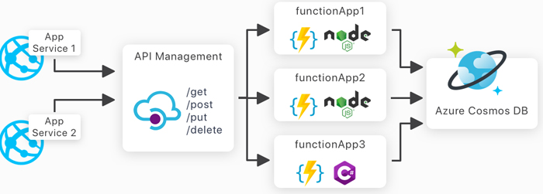
Azure Functions and API

Slide 31
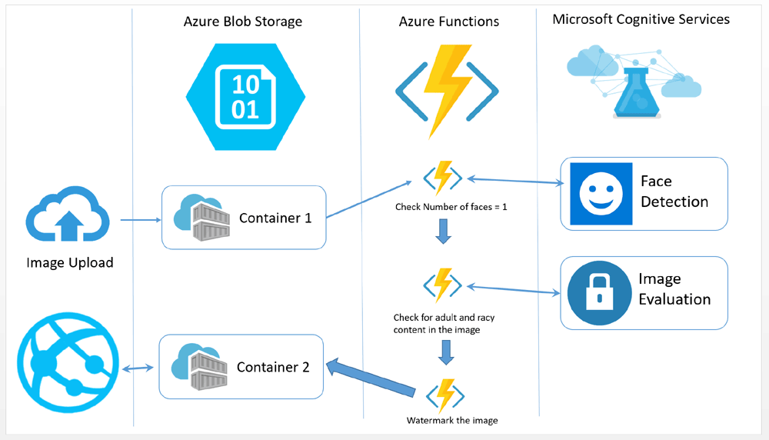
Azure Functions and Cognitive Services

Slide 32
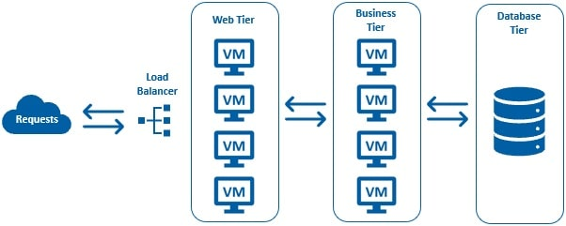
Azure VMSS

Slide 33
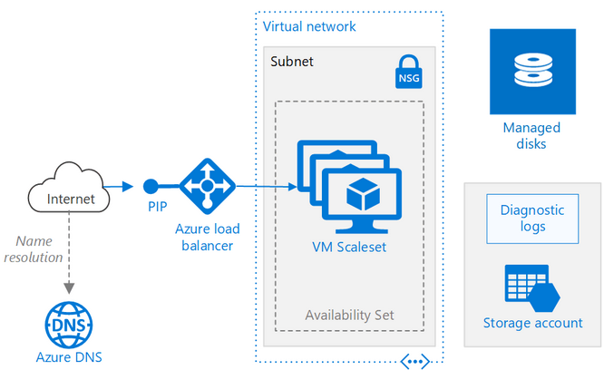
Azure VMSS

Slide 34
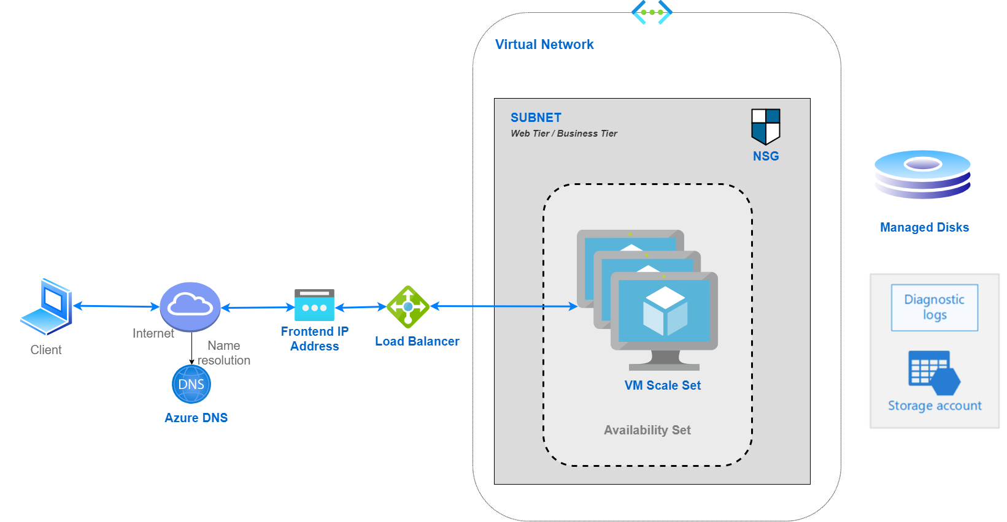
Azure VMSS

Slide 35

Azure VMSS

Slide 36
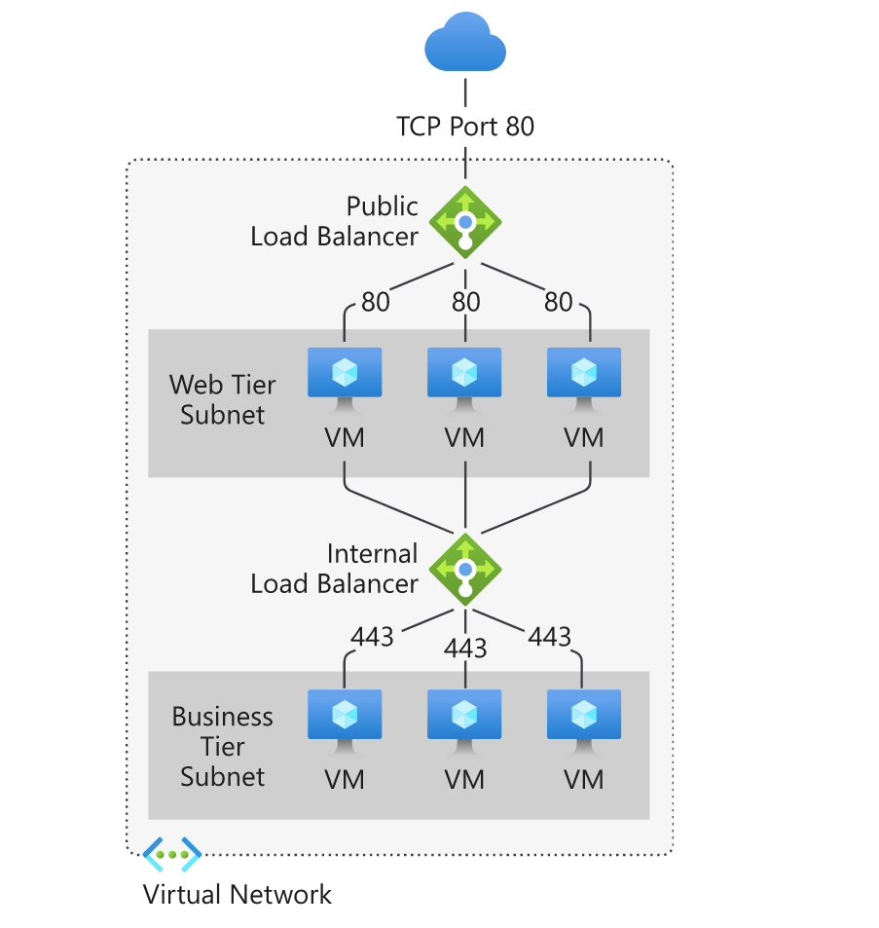
Azure VMSS

Slide 37
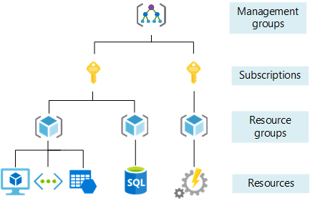
Azure Management Group and Subscription

Slide 38
Azure Management Groups
Azure Management Groups, Subscriptions, and Resource Groups are used together to establish the entire organizational structure in Azure
Designed to be flexible to organize Azure resources to meet business needs.
Azure management groups provide a level of scope above subscriptions
Azure provides four levels of management scope:
Management groups
Subscriptions
Resource groups
Resources

Slide 39
Root management group for each directory
Each directory is given a single top-level management group called the root management group
This root management group allows for global policies and Azure role assignments to be applied at the directory level

Slide 40
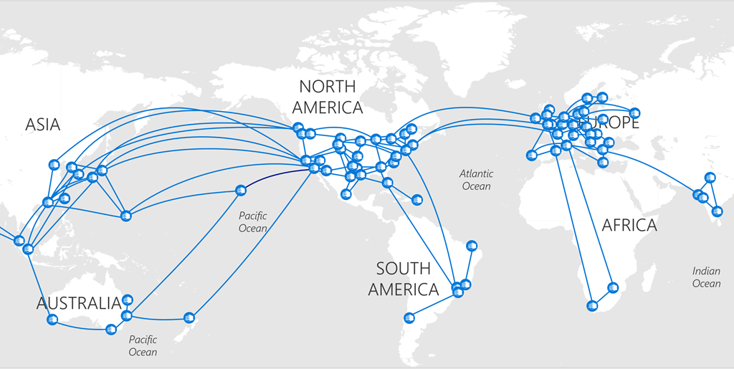
Azure Regions

Slide 41
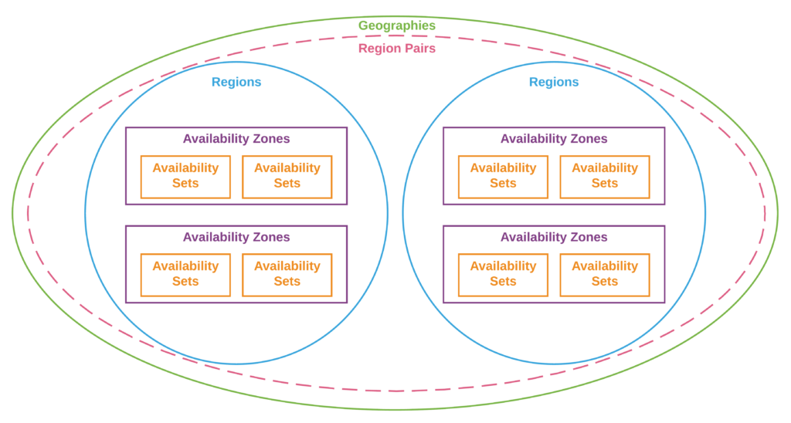
Azure Regions

Slide 42
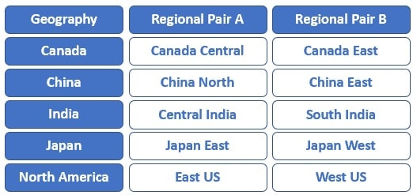
Azure Regions

Slide 43
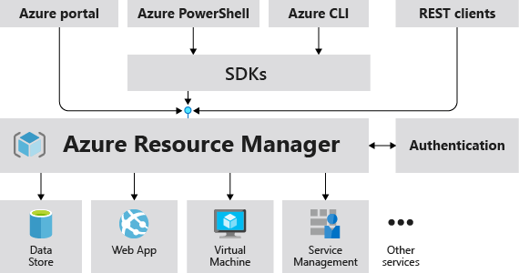
Azure Resource Manager

Slide 44
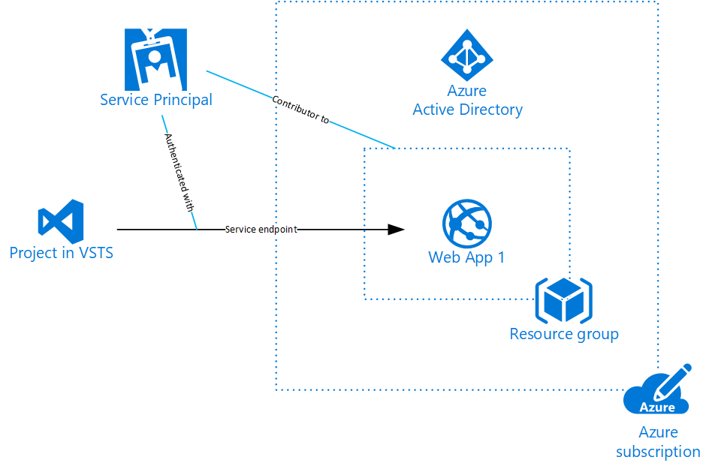
Azure Service Principals

Slide 45
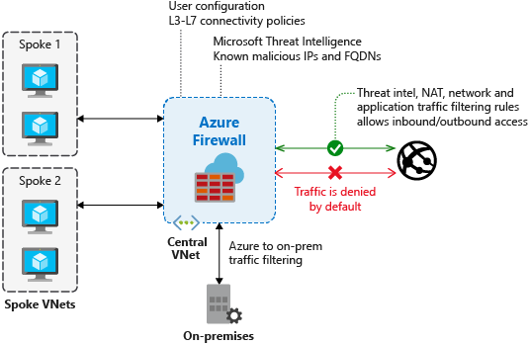
Azure Firewall

Slide 46
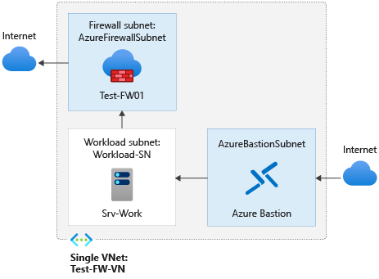
Azure Firewall

Slide 47
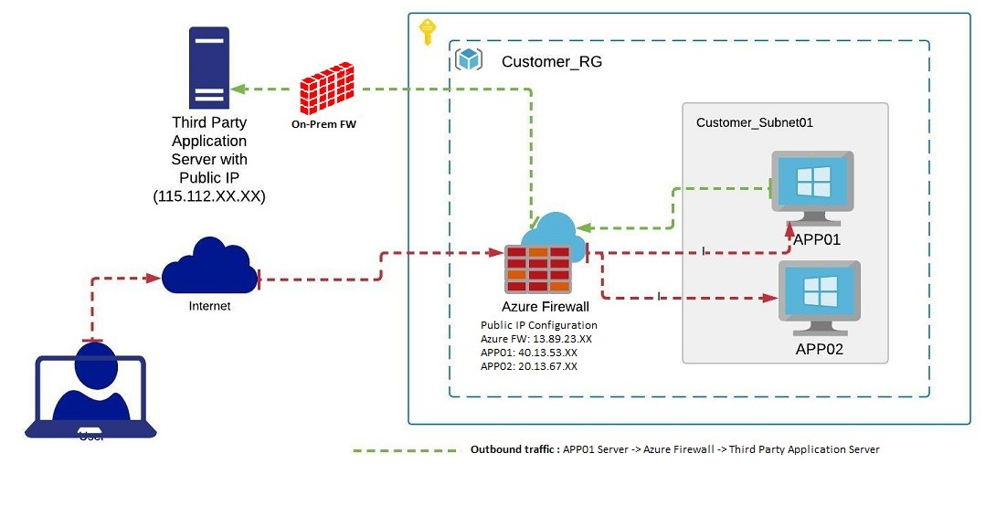
Azure Firewall

Slide 48
Steps to create Azure Firewall
Create a resource group
Create a VNet
Create a virtual machine
Deploy the firewall
Create a route table
Associate Default Subnet
Add Route
Destination: 0.0.0.0/0
Next Hop Type: Virtual Appliance
Next hop address: 10.0.1.4 (Private IP of Firewall)
Add DNAT rule in Firewall Policy

Slide 49
Steps to create Azure Firewall
Add Application rule in Firewall Policy

Slide 50
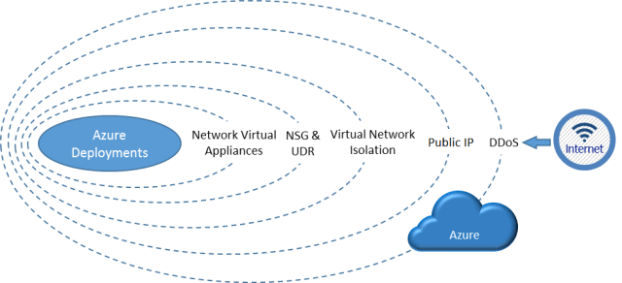
Azure DDos Protection

Slide 51
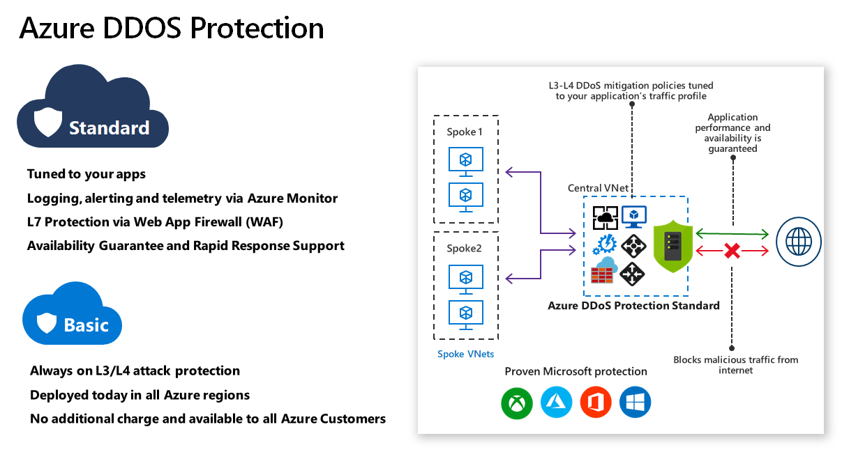
Azure DDos Protection

Slide 52
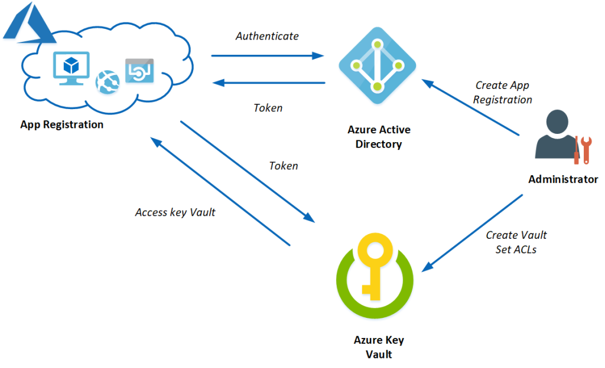
Azure Key Vault

Slide 53
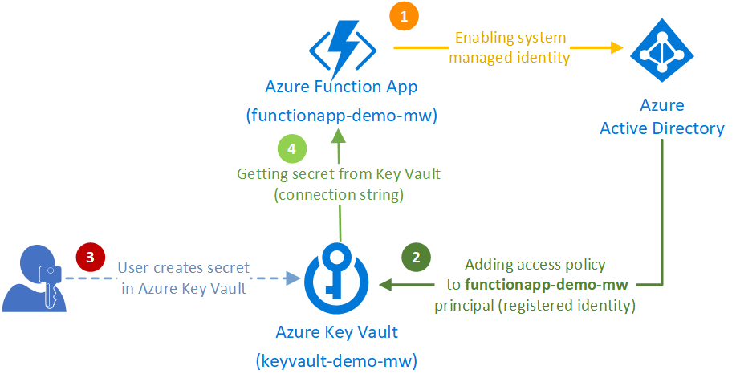
Azure Key Vault

Slide 54
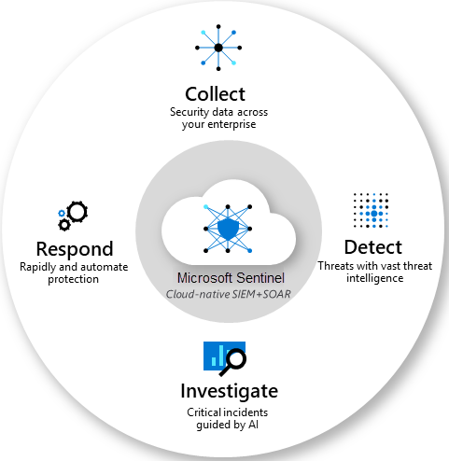
Microsoft Sentinel

Slide 55
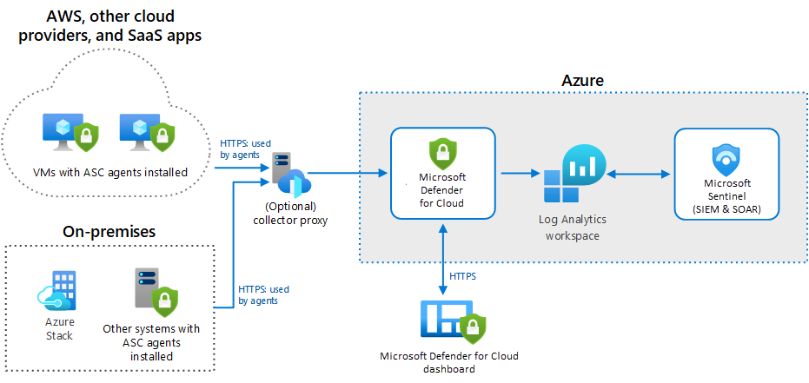
Microsoft Sentinel

Slide 56
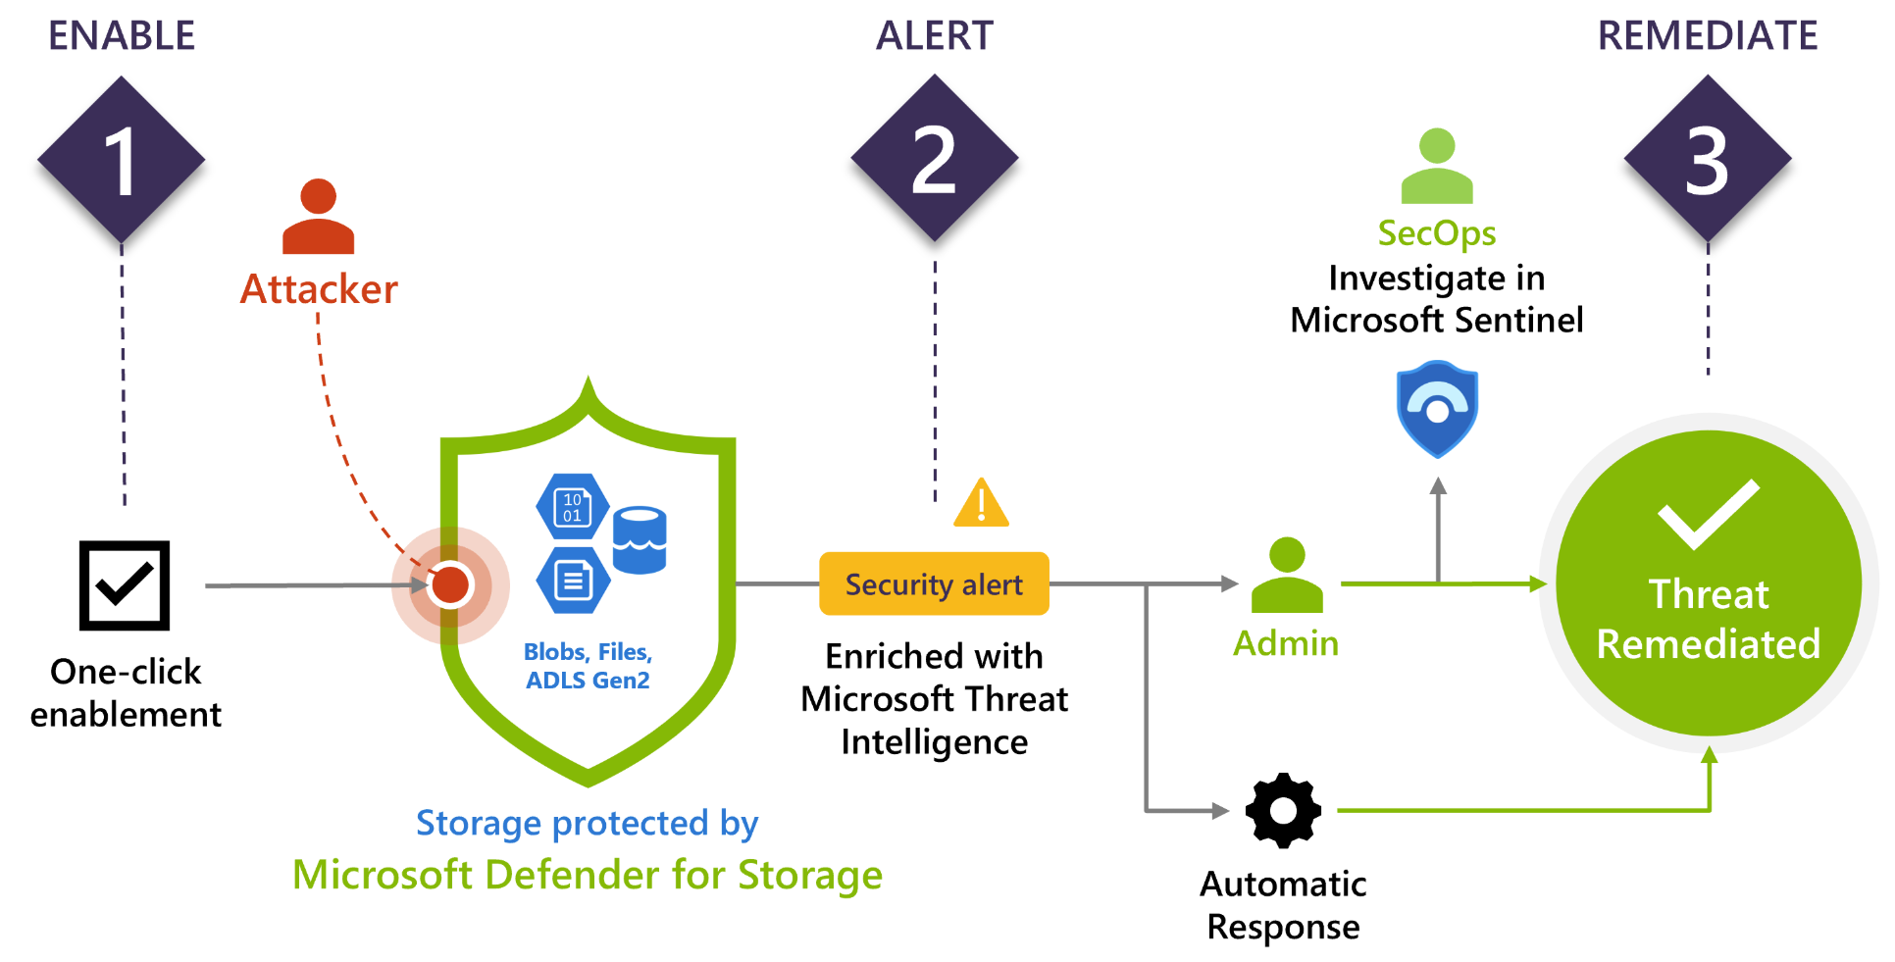
Microsoft Defender for Cloud

Slide 57
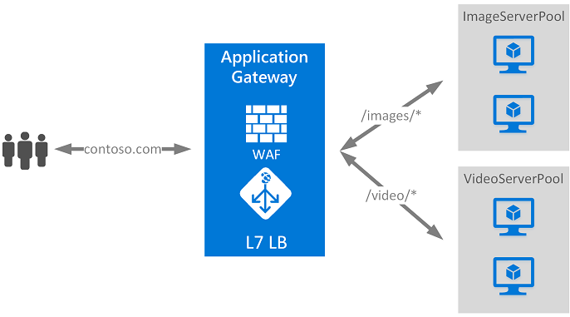
Application Gateway

Slide 58

Azure Storage

Slide 59

Azure DNS

Slide 60

Azure DNS

Slide 61

Azure Advisor

Slide 62

ARM Templates

Slide 63

Azure Monitor

Slide 64

Azure Service Health

Slide 65

Azure Service Health

Slide 66

Azure Log Analytics

Slide 67
Azure identity, governance, privacy, and compliance

Slide 68

Azure Authentication and Authorization

Slide 69

Azure AD

Slide 70

Azure RBAC

Slide 71

Azure Resource Locks

Slide 72
Azure Cost Management

Slide 73

Cost Management

Slide 74

Pricing Calculator

Slide 75
Deploy ARM Templates using Azure CLI
Open Azure CLI and run below commands
az group create --name ExampleGroup --location "Central US"
az deployment group create \
--name ExampleDeployment \
--resource-group ExampleGroup \
--template-uri "https://raw.githubusercontent.com/Azure/azure-quickstart-templates/master/quickstarts/microsoft.storage/storage-account-create/azuredeploy.json" \
--parameters storageAccountType=Standard_GRS

Slide 76

Conditional Access

Slide 77
Enable Conditional Access
Browse to Azure Active Directory > Security > Conditional Access
Add New policy
Need to enable Azure AD Premium P2 first
Under Assignments, select Users and groups
Select Done.
Under Cloud apps or actions > Include, select All cloud apps.
Under Access controls > Grant, select Grant access, Require multi-factor authentication, and select Select.
Confirm your settings and set Enable policy to Report-only.
Select Create to create to enable your policy.

Slide 78
Azure Cost Management
Cost Management uses Azure management groups, budgets, and recommendations to show clearly how your expenses are organized and how you might reduce costs
You can use the Azure portal or various APIs for export automation to integrate cost data with external systems and processes

Slide 79
Total Cost of Ownership
The TCO Calculator lets you create a customised business case to justify migration to Azure
You have the option to modify any assumptions so the model accurately reflects your business
The result is a detailed report which shows how much money you can save by moving to Azure.
Calculator
https://azure.microsoft.com/en-in/pricing/tco/calculator/

Slide 80
Thanks

